Slide 1

Online Examination system
Dhruvkumar D Patel
Dhaval N Patel
Guided By :- Dr Hiren B Patel

Slide 2
Introduction
The purpose of online test simulator is to take online test in an efficient manner and no time wasting for checking the paper.
The main objective of online test simulator is to efficiently evaluate the candidate thoroughly through a fully automated system that not only saves lot of time but also gives fast results
The effective use of “Online Examination system” , any Educational Institute or training centres can use it to develop their strategy for putting the exam and getting better result on less time

Slide 3
OBJECTIVE
Online Examination will reduce hectic jobs assessing answer given by the candidates manually
Begin an integrated Online Examination system it will reduce paper work #GoGreen
To allow faculty to create their own test and answer key
To allow Automatic grading and manual grading which can be recorded per test
Result will be shown immediately to the participating students

Slide 4
FEATURES
Auto Grading
Flexible
Time saver
Store repository of exam
Security
Accurate & Reliable
Develop a system which allow faculty to create, modifying store Question which can be group together to form tests

Slide 5
Software Requirements specification
Operating system :- Mac OS , Windows , linux etc
Front End :- Angular.js , HTML, CSS
Back End :- MySQL, Spring Boot,JDK
Web Browser :- Chrome, Safari etc
Hardware:-
1 Gb RAM
Dual Core or above
Hard Disk Space 2 Gb

Slide 6
Student Aspect
Requesting Registration
Logging into the system
Selecting test
Appearing for the examination
Getting the result

Slide 7
Administration Aspect
Editing/Deleting/Creating the databases
Logging into system
Accepting registration
Creating test
Preparing Excel document comprising different type of question with their correct answer
Time limit of test if any

Slide 8
Exam MOdule
Examination Process
Login the online examination system
Attend test
Submit
The form of Question
Multiple choice Question
Fill in the Blank
True or false

Slide 9
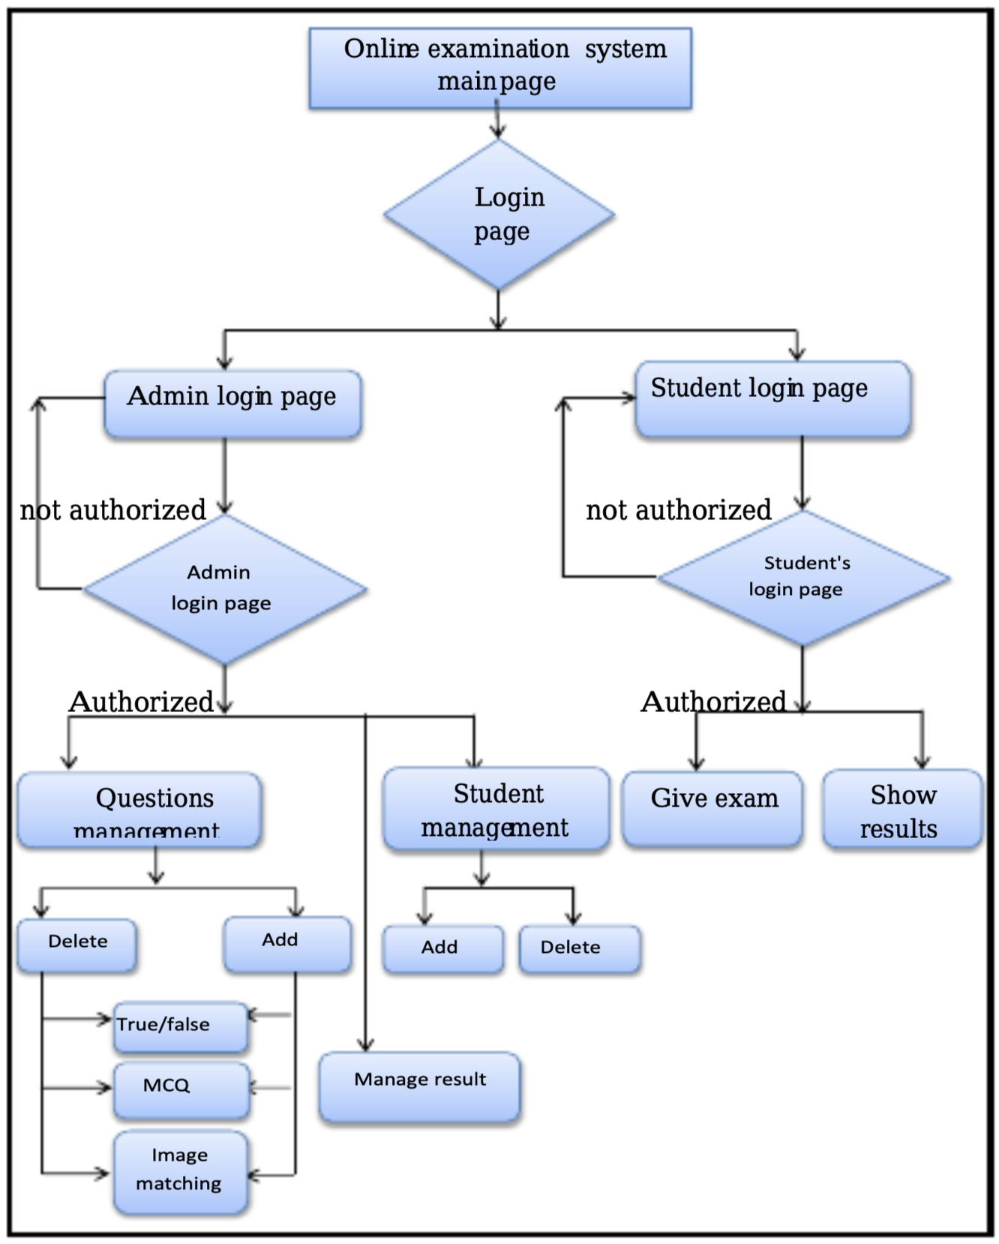

Slide 10
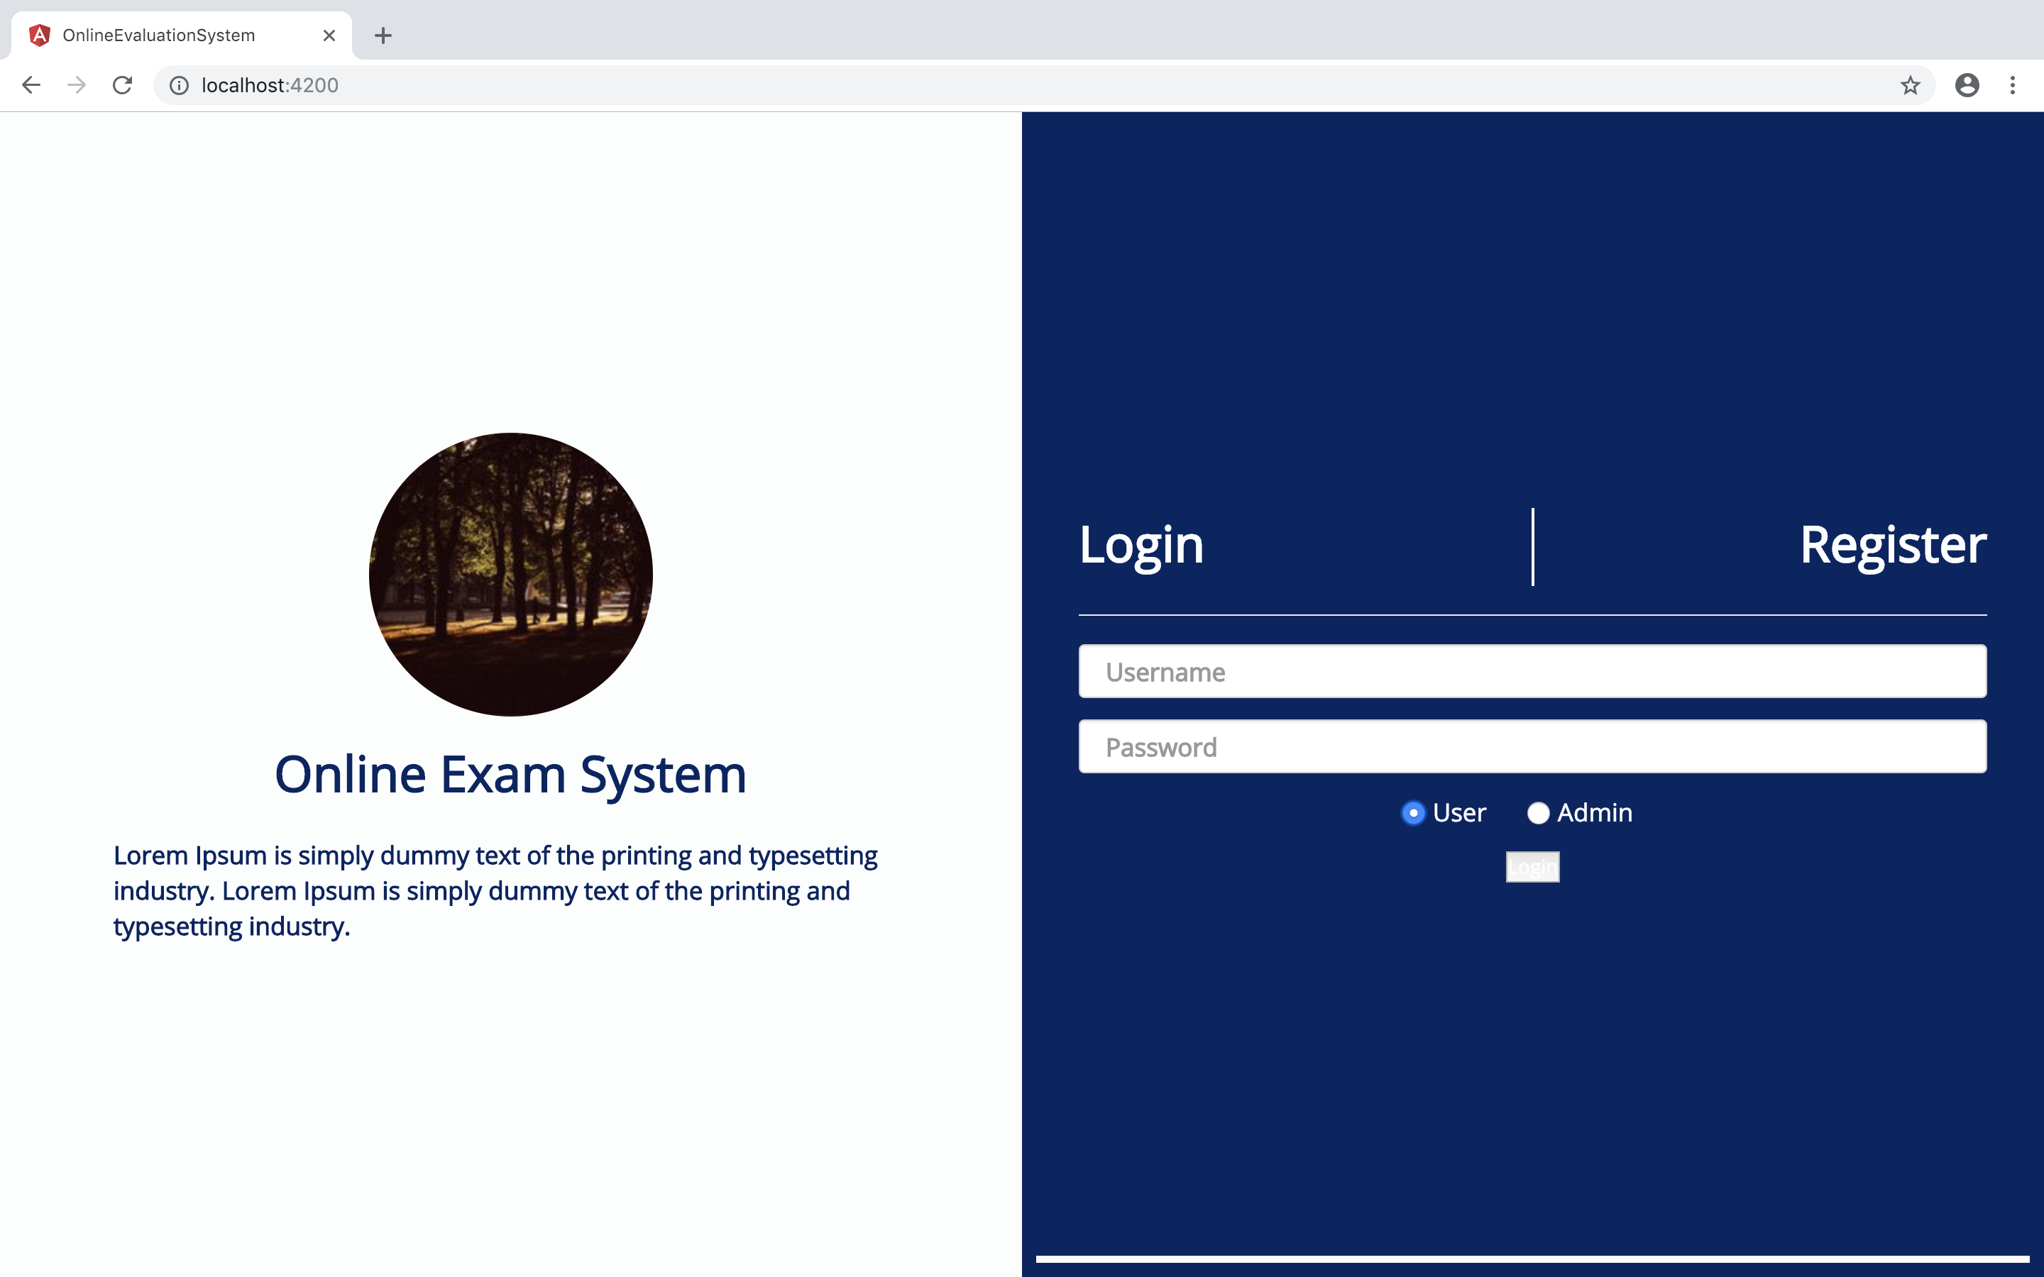



Candidate login
Enter the Username and Password and it will lead the candidates to Exam section
Admin Login
Enter the username and Password and it will lead you to admin functionalities

Slide 11
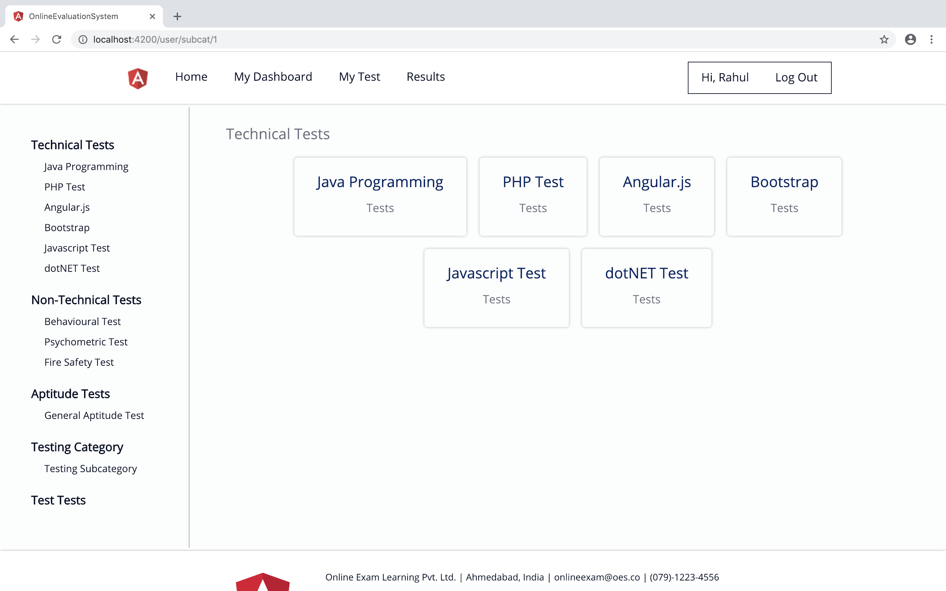



Different types of Tests
Different types of Tests

Slide 12
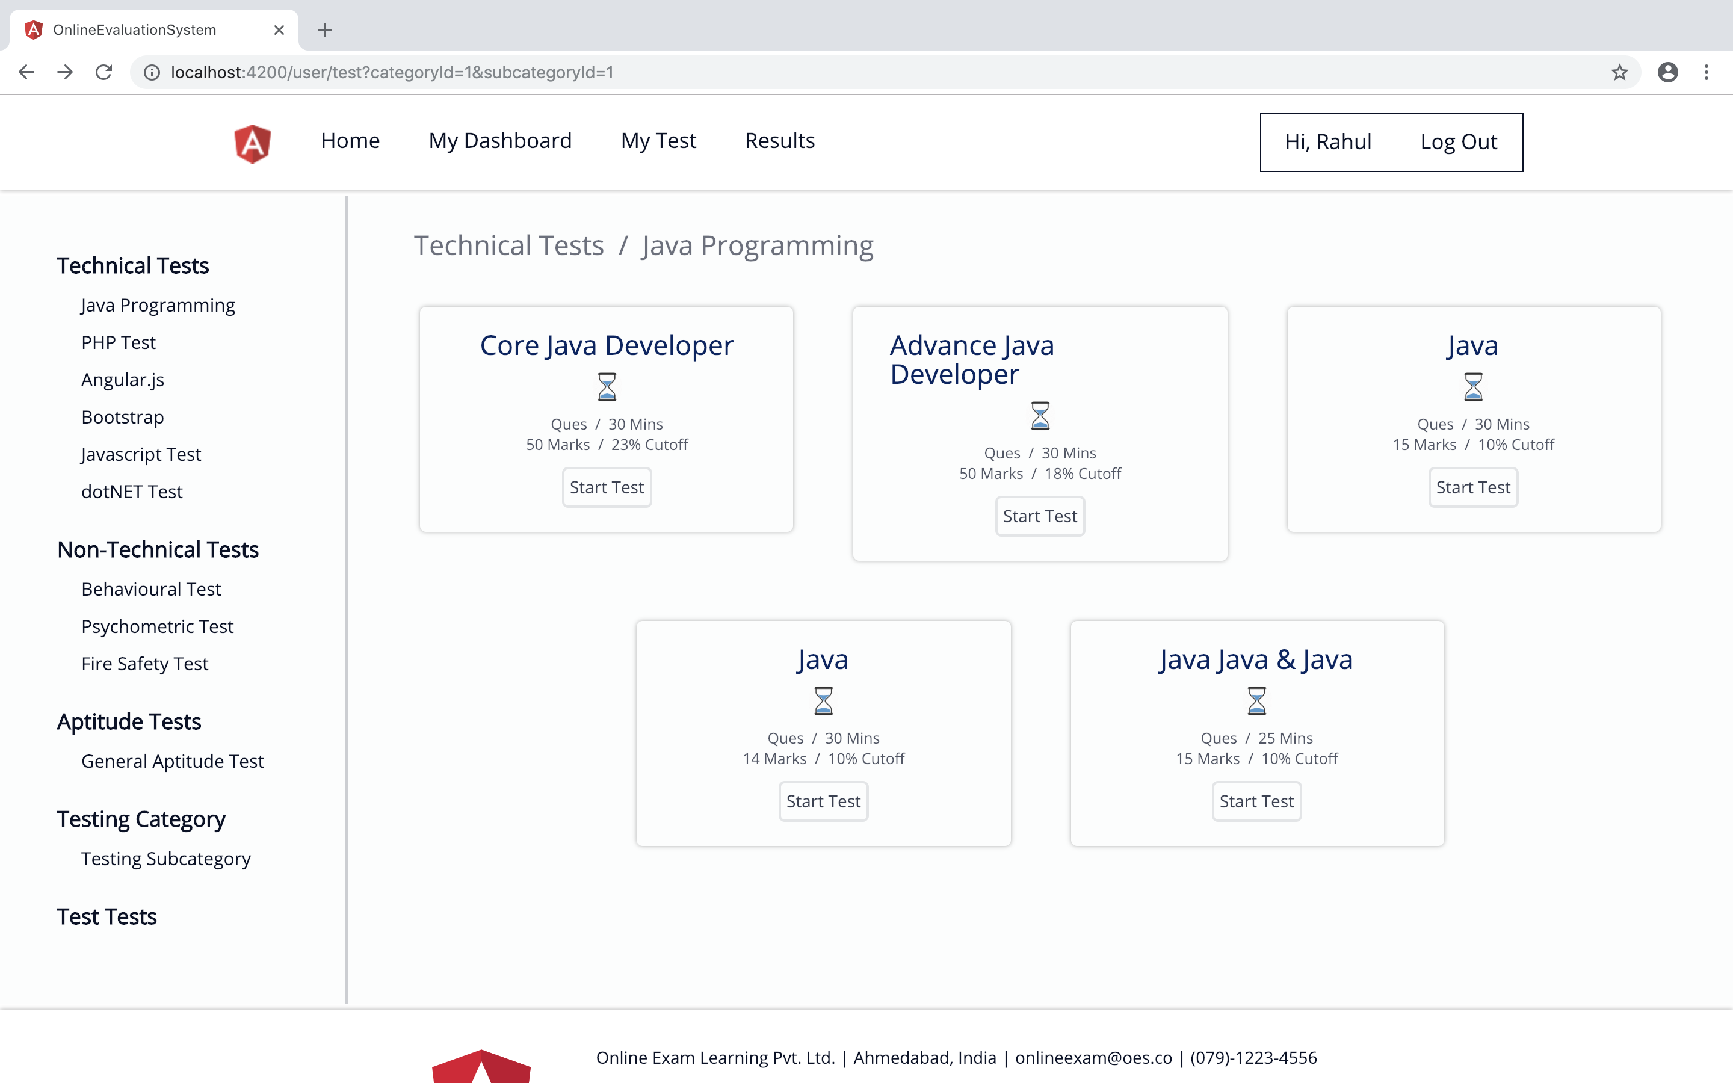

Subcategory of Java Programming

Slide 13

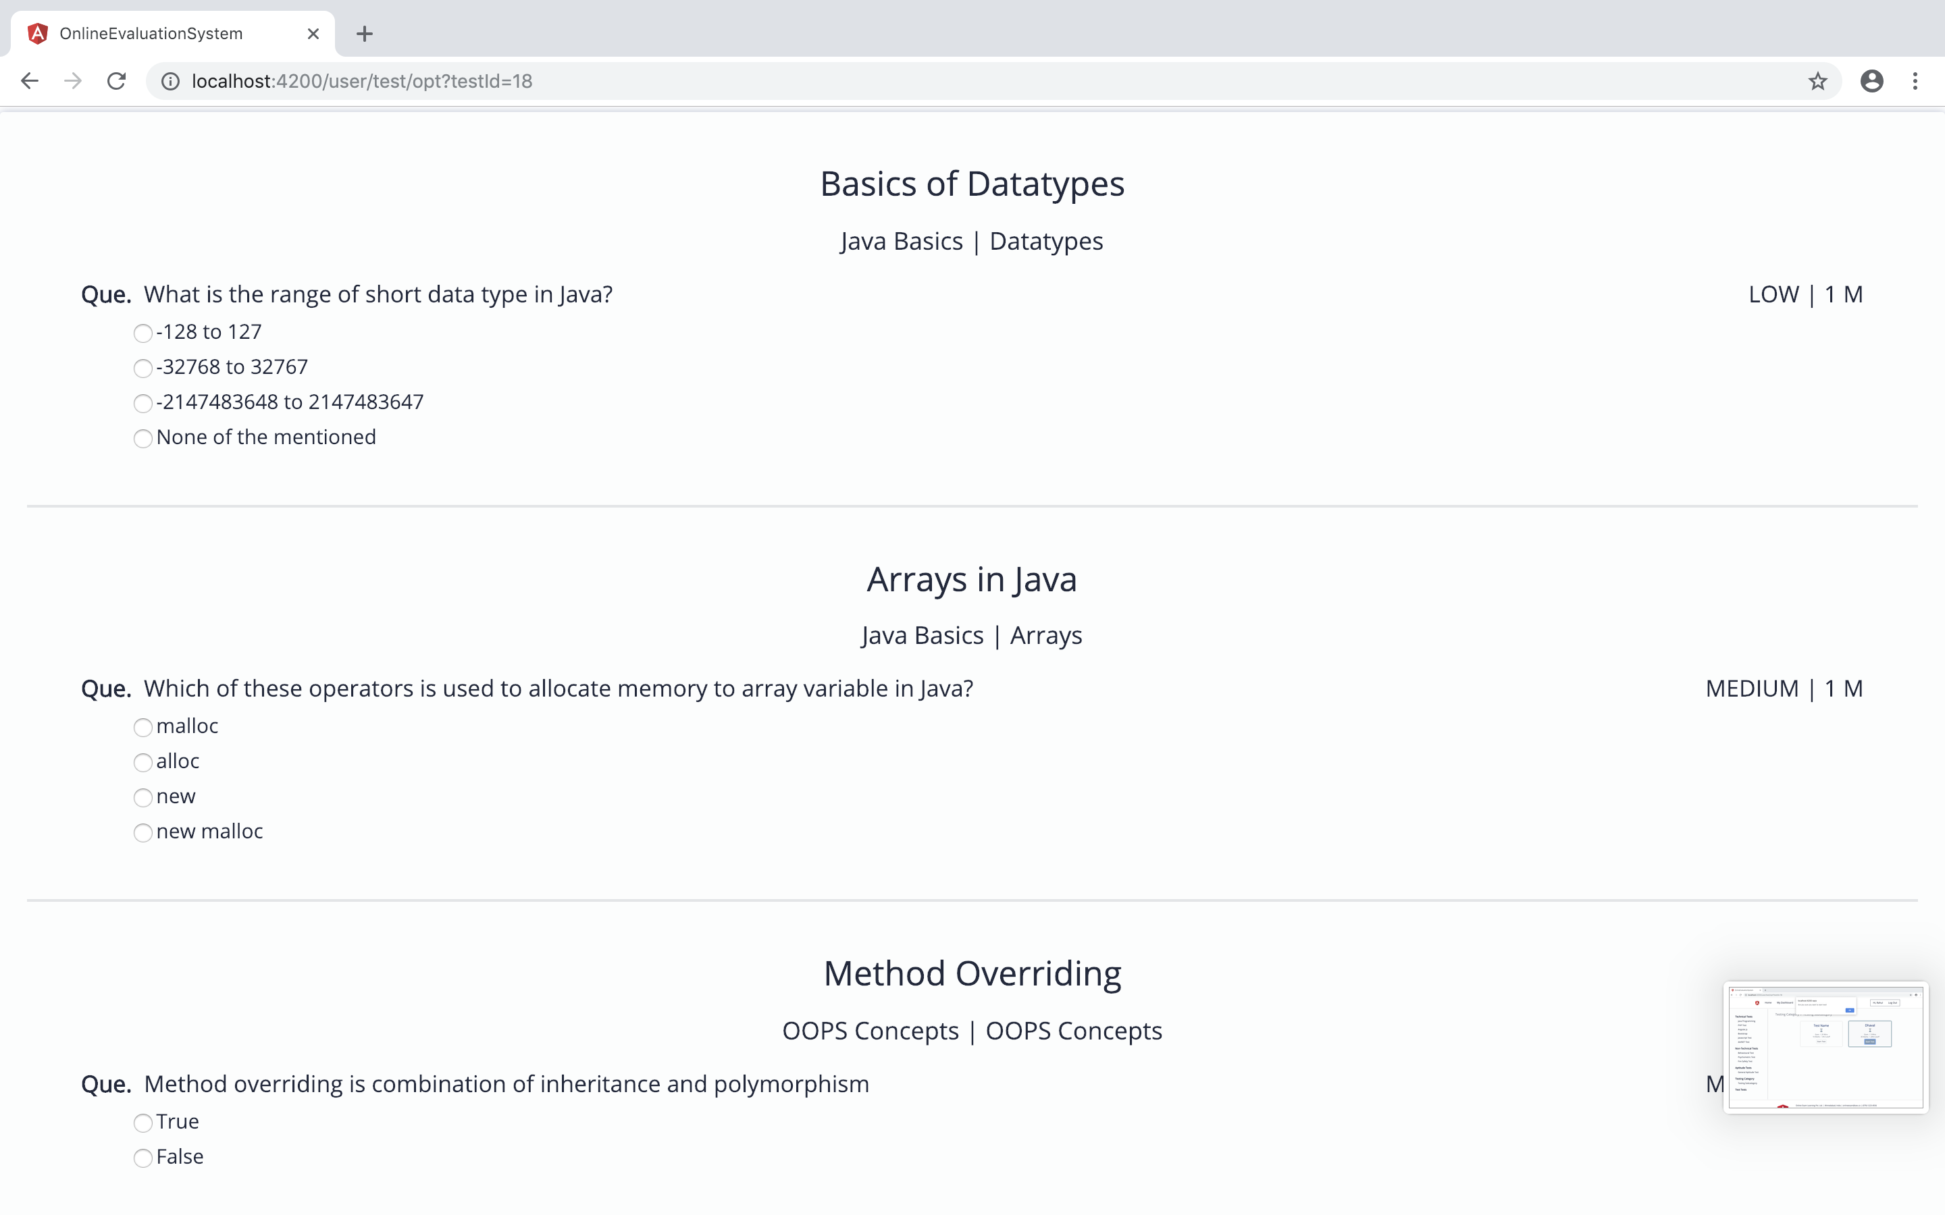
Text Questions

Slide 14
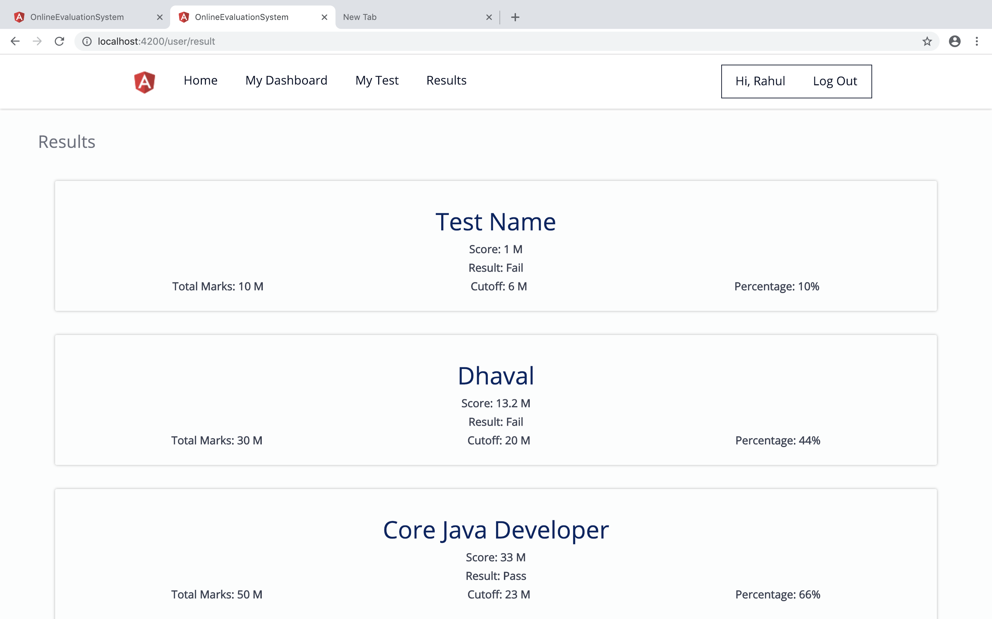

Results

Slide 15
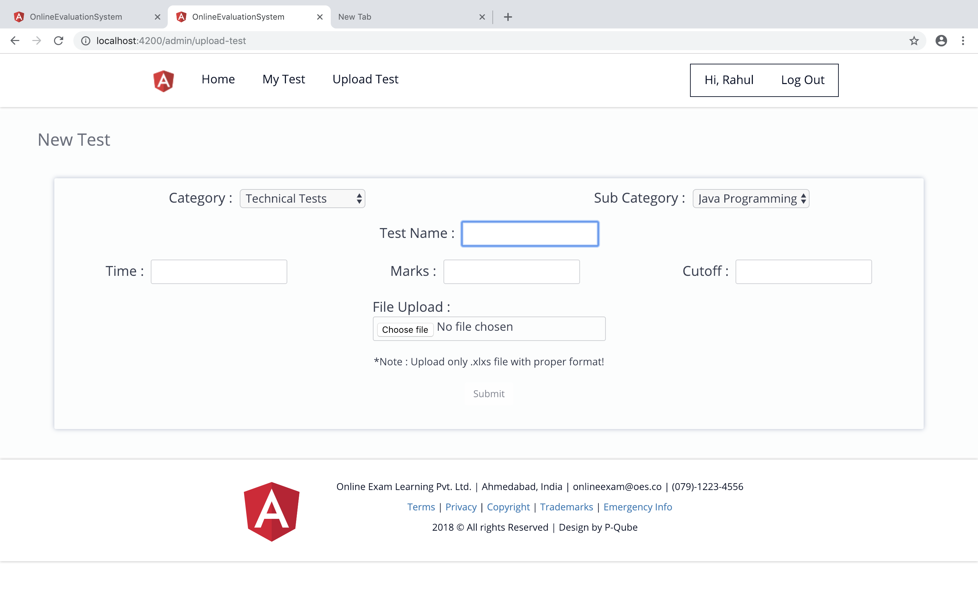


Admin Module
Inserting new Test
Only Excel File

Slide 16
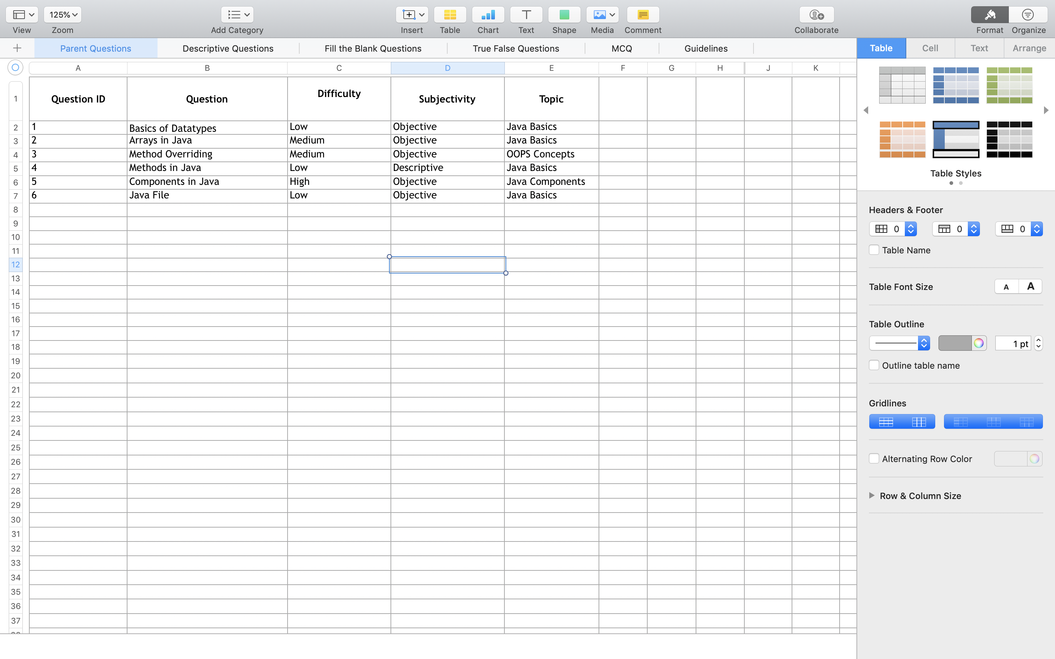

Excel Document

Slide 17
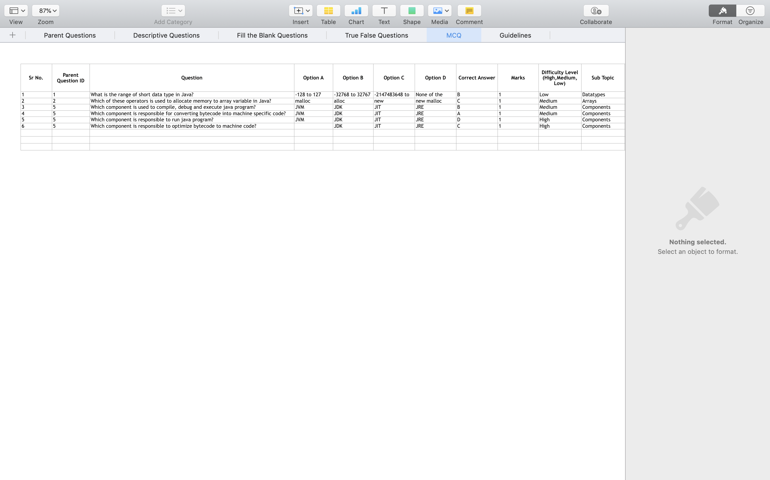



Questions
Correct Answer
Question ID

Slide 18
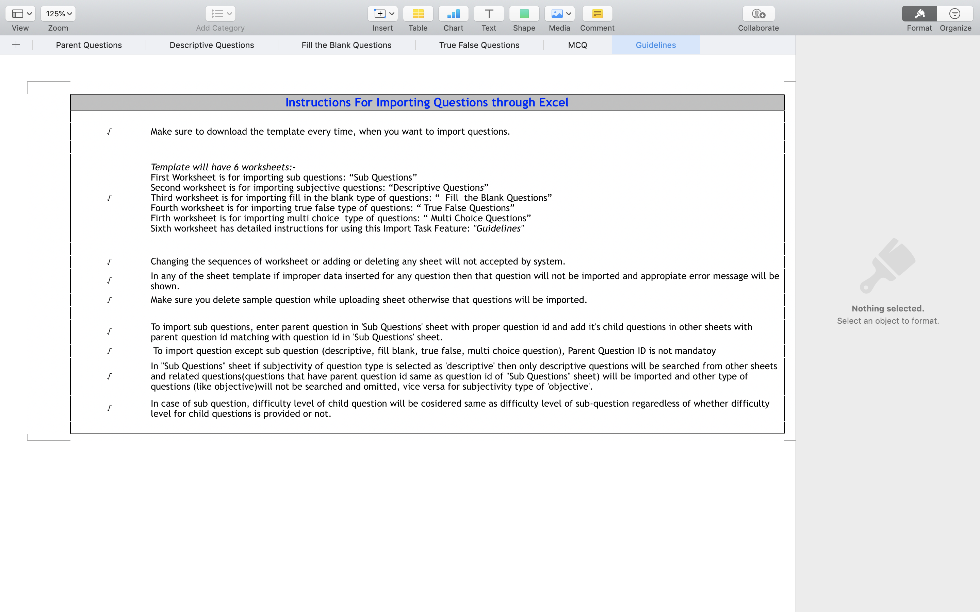

Slide 19
Scope
Scope of this project is very broad in terms of other manually taking exam
Few of them :-
Can be used in educational institute as well as in corporate world
Can be used anywhere anytime as it is web application
No Restriction that examiners to be present when candidate gives test
Design to facilitate Administration and User
Online Examination designed for educational institutes like School, Colleges and private institute to conduct logic tests of their students employees on regular basis

Slide 20
Conclusion
Online Examination system is a wed application. The key concept of the application in to minimise the amount of paper work and convert all form of documentation to digital form
It can be observe that the information require can be obtained with ease and accuracy in the computerised system
System also produce brief result required by the management

Slide 21
Bibliography
https://angularjs.org
https://www.w3schools.com
spring.io/projects/spring-boot
https://www.baeldung.com/spring-boot
https://www.tutorialspoint.com
https://stackoverflow.com

Slide 22

THANK YOU

